Slide 2
Interpretable Anomaly Detection in the LHC Main Dipole Circuit with Non-negative Matrix Factorization
Christoph Obermair, TE-MPE-CB
Acknowledgement:
Marvin Janitschke, TE-MPE-PE
Emmanuele Ravaioli, TE-MPE-PE
Mariusz Wozniak, TE-MPE-PE
Zinour Charifoulline, TE-MPE-PE
Lukas Felsberger, TE-MPE-MI
Daniel Wollmann, TE-MPE-CB
Aleksandra Mnich, TE-MPE-CB
Franz Pernkopf, TU-Graz

Slide 3
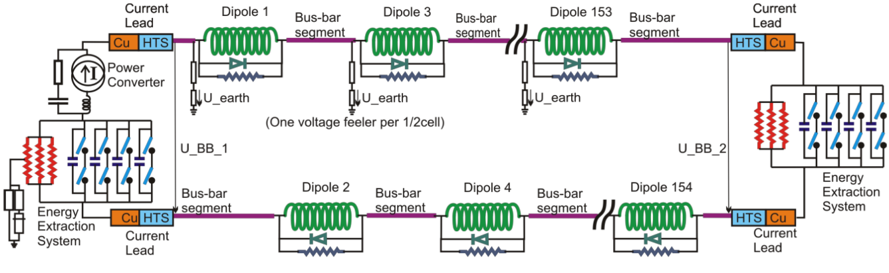
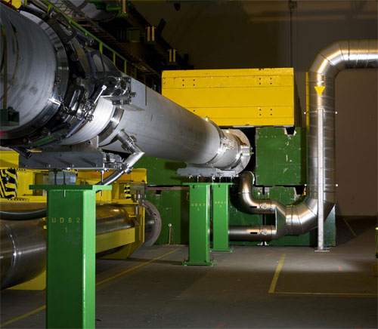
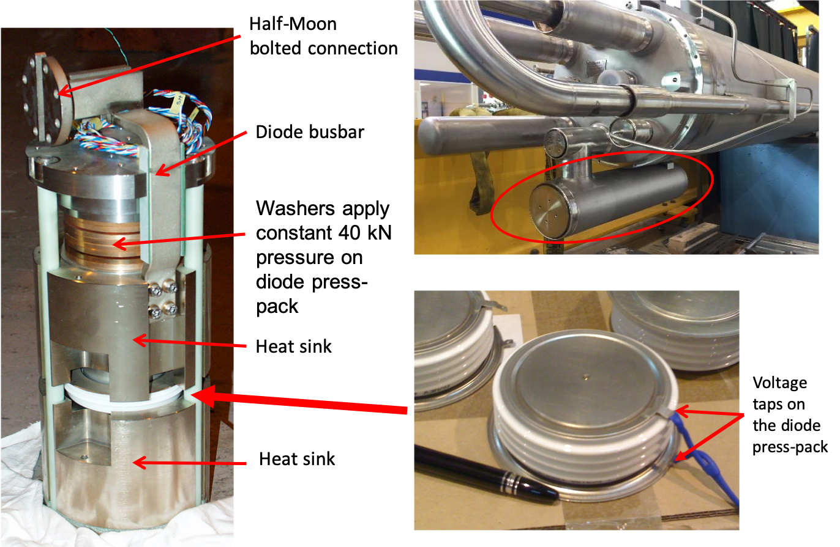
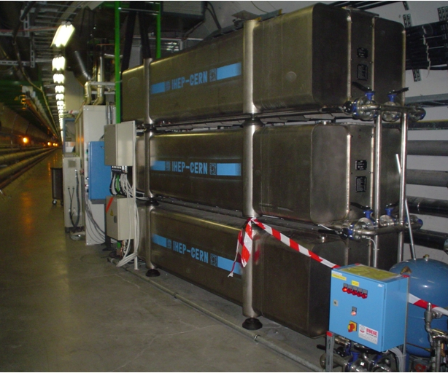
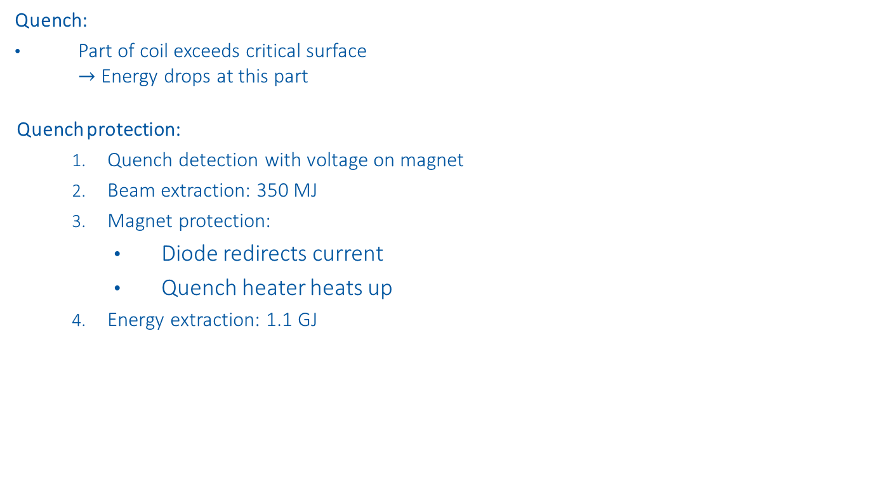
LHC Main Dipole Circuit
Quench:
Part of coil exceeds critical surface $→$ Energy drops at this part
Quench protection:
Quench detection with voltage on magnet
Beam extraction: 350 MJ
Magnet protection:
Diode redirects current
Quench heater heats up
Energy extraction: 1.1 GJ
Beam Extraction
Diode
Energy Extraction

Slide 4
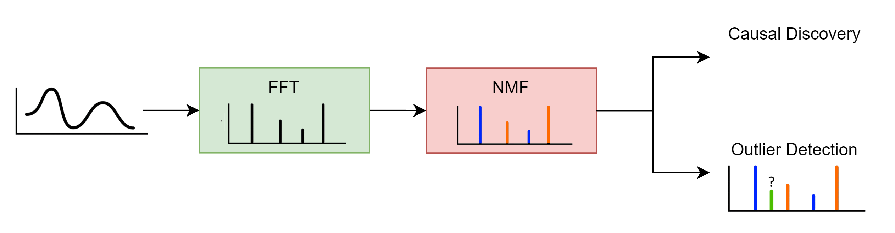
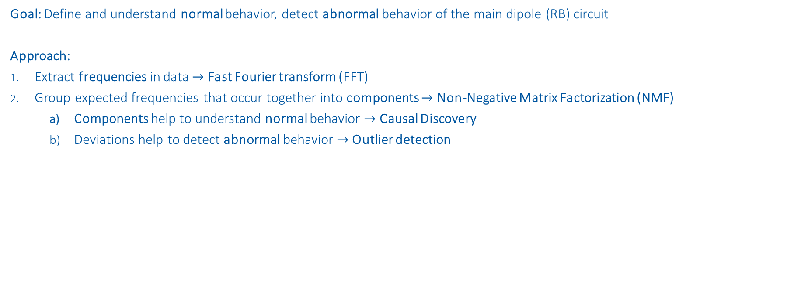
Outline
Goal: Define and understand normal behavior, detect abnormal behavior of the main dipole (RB) circuit
Approach:
Extract frequencies in data $→$ Fast Fourier transform (FFT)
Group expected frequencies that occur together into components $→$ Non-Negative Matrix Factorization (NMF)
Components help to understand normal behavior $→$ Causal Discovery
Deviations help to detect abnormal behavior $→$ Outlier detection

Slide 5
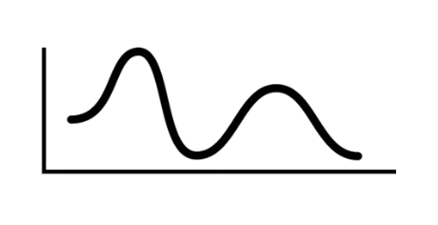
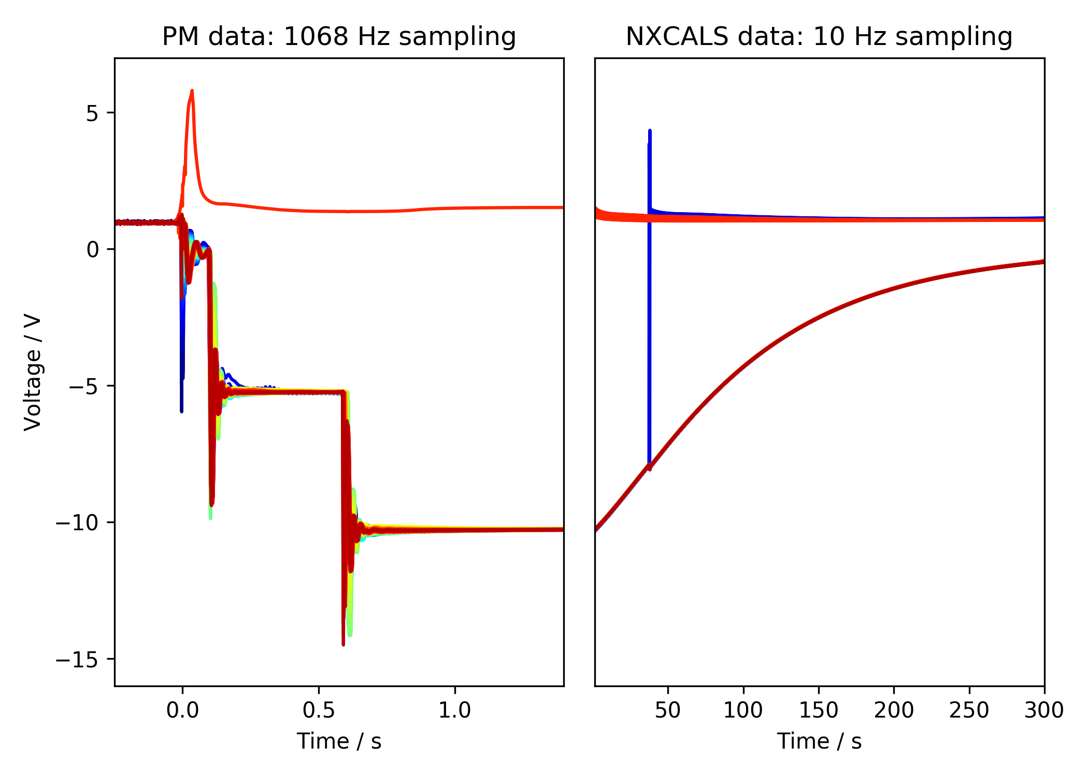
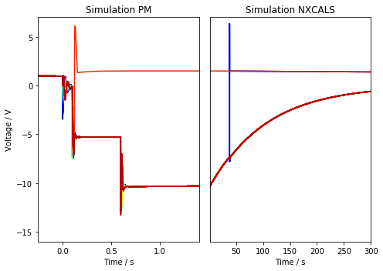
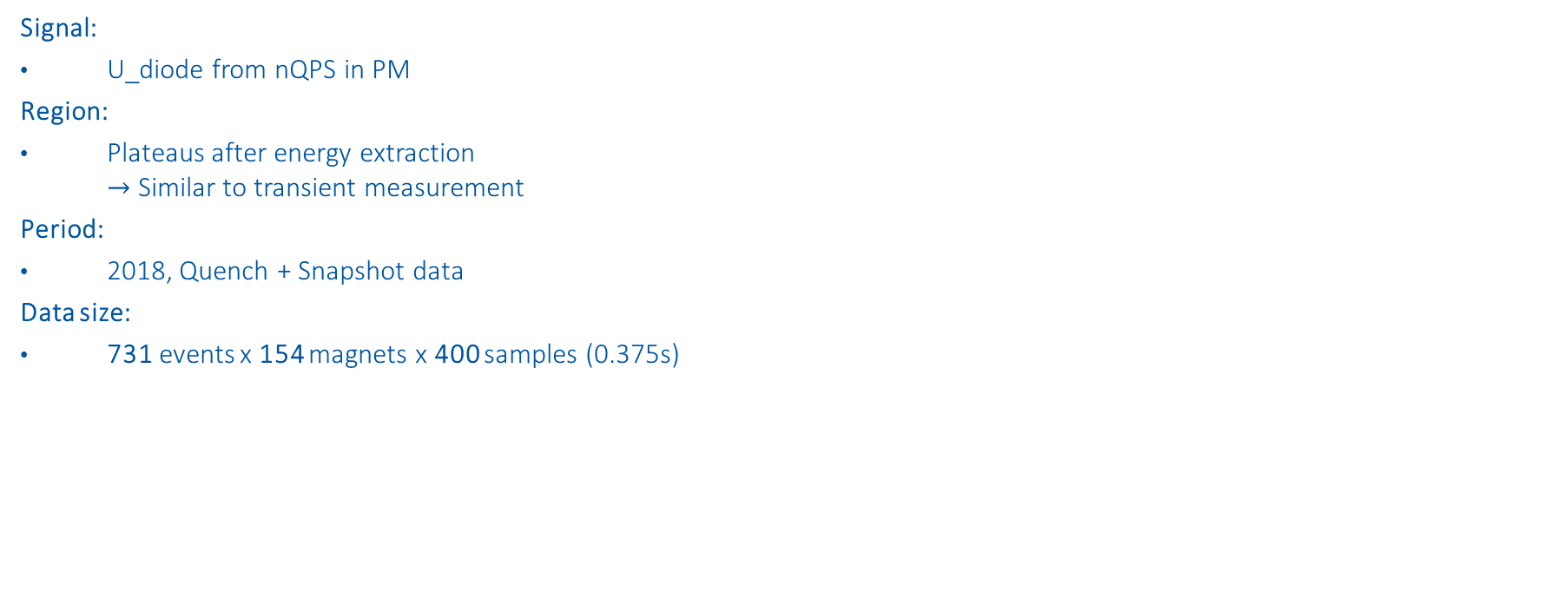
Select data
Signal:
U_diode from nQPS in PM
Region:
Plateaus after energy extraction $→$ Similar to transient measurement
Period:
2018, Quench + Snapshot data
Data size:
731 events x 154 magnets x 400 samples (0.375s)
1st EE
Plateau
2nd EE
Plateau
2nd EE switch off
*simulations done by Marvin Janitschke with STEAM framework
1st EE switch off
PC Switch off

Slide 6
Fast Fourier transform
Extract frequencies in data

Slide 7
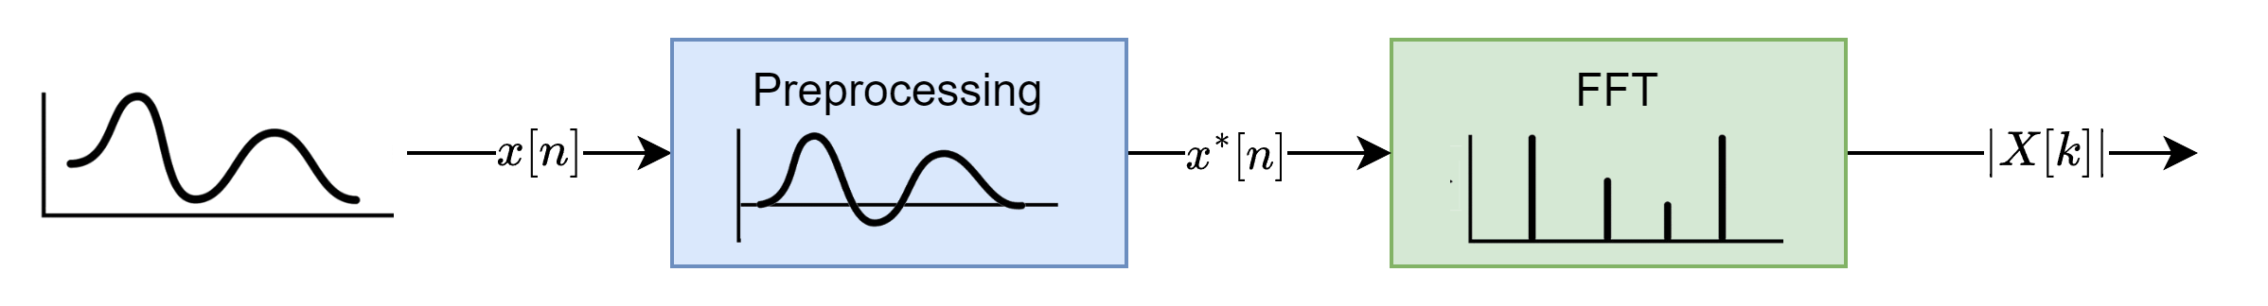
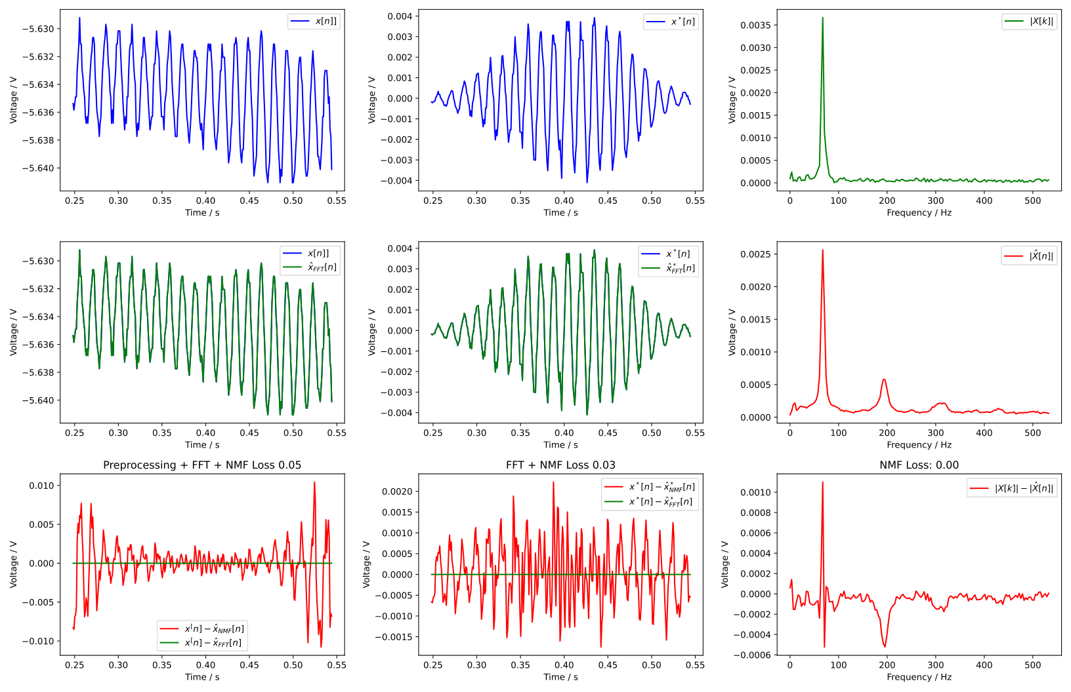
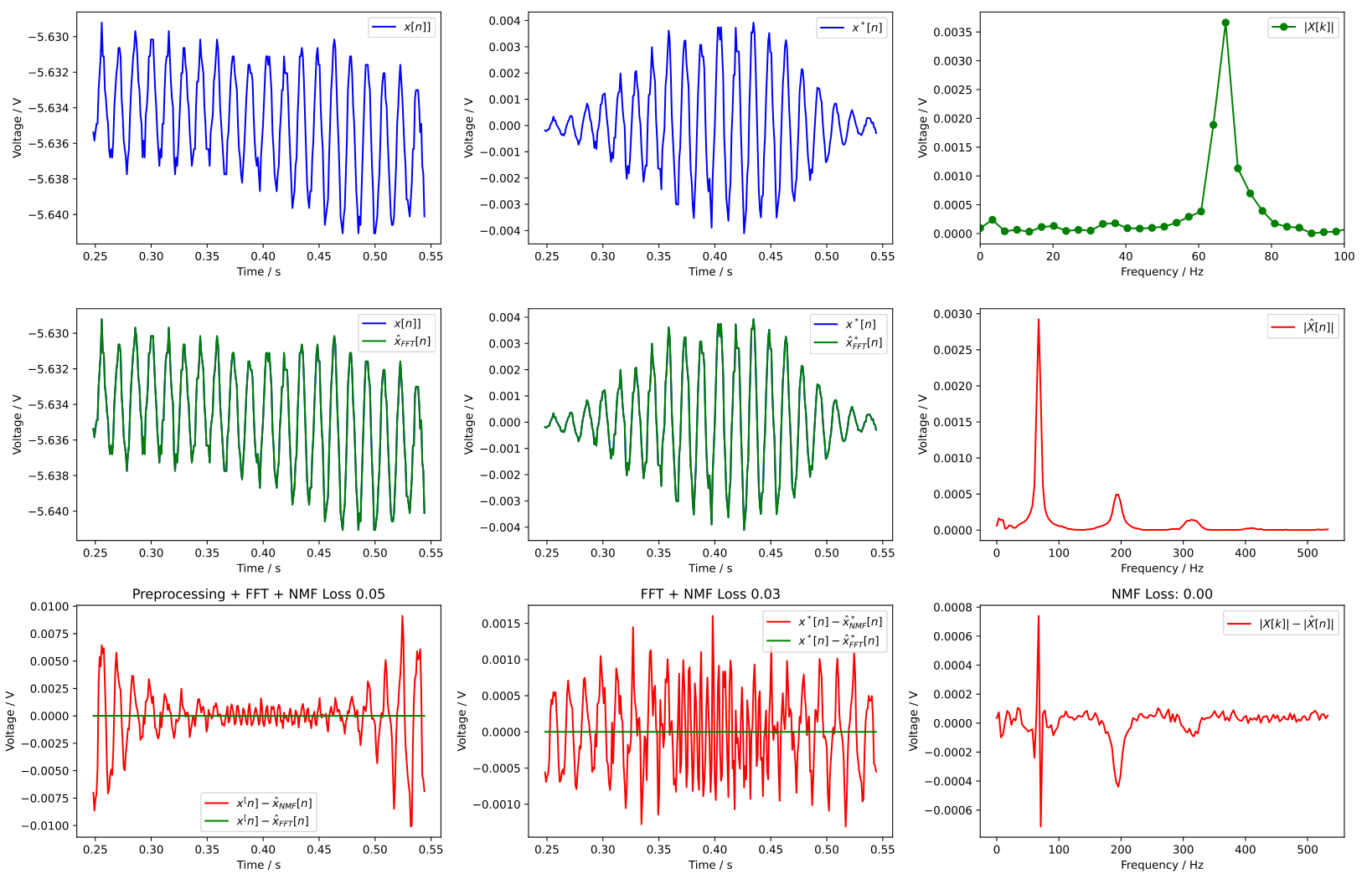
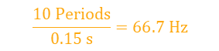

Fast Fourier transform
Example signal: B21R3 on 2021-04-18 08:44:17
Preprocessing necessary to minimize spectral leakage:
Subtract offset
Multiplication with window
$$\frac{10 Periods}{0.15 s}=66.7 Hz$$
$$67.4 Hz$$

Slide 8
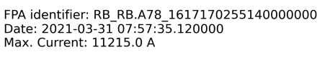
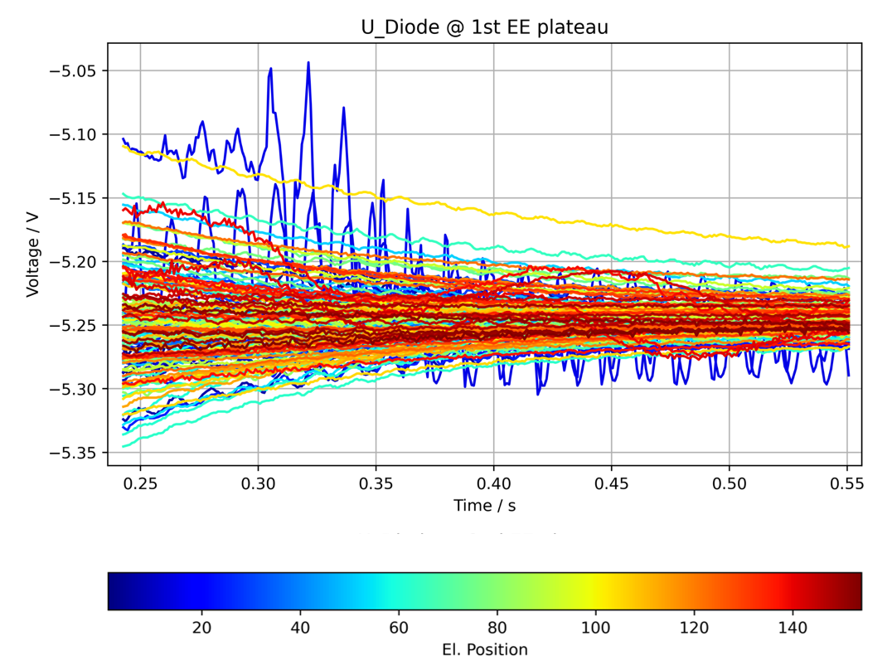
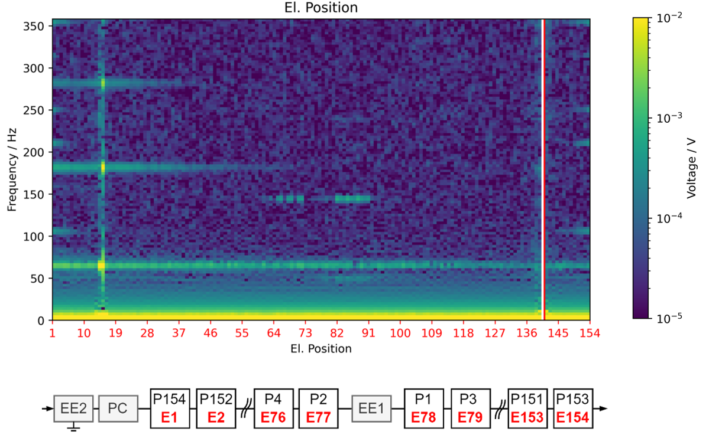
Frequency Position Maps (FPM)
Normal event
1st EE
Plateau
fft
2nd EE
Plateau
2nd EE switch off
1st EE switch off
PC Switch off

Slide 9
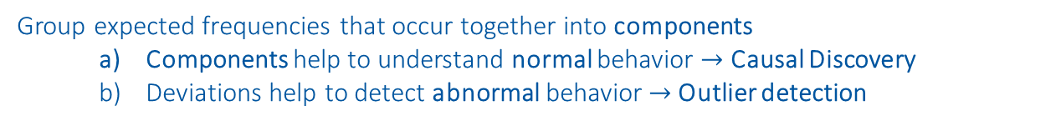
Non-Negative Matrix Factorization (NMF)
Group expected frequencies that occur together into components
Components help to understand normal behavior $→$ Causal Discovery
Deviations help to detect abnormal behavior $→$ Outlier detection
https://www.nature.com/articles/44565
https://proceedings.neurips.cc/paper/2000/file/f9d1152547c0bde01830b7e8bd60024c-Paper.pdf

Slide 10
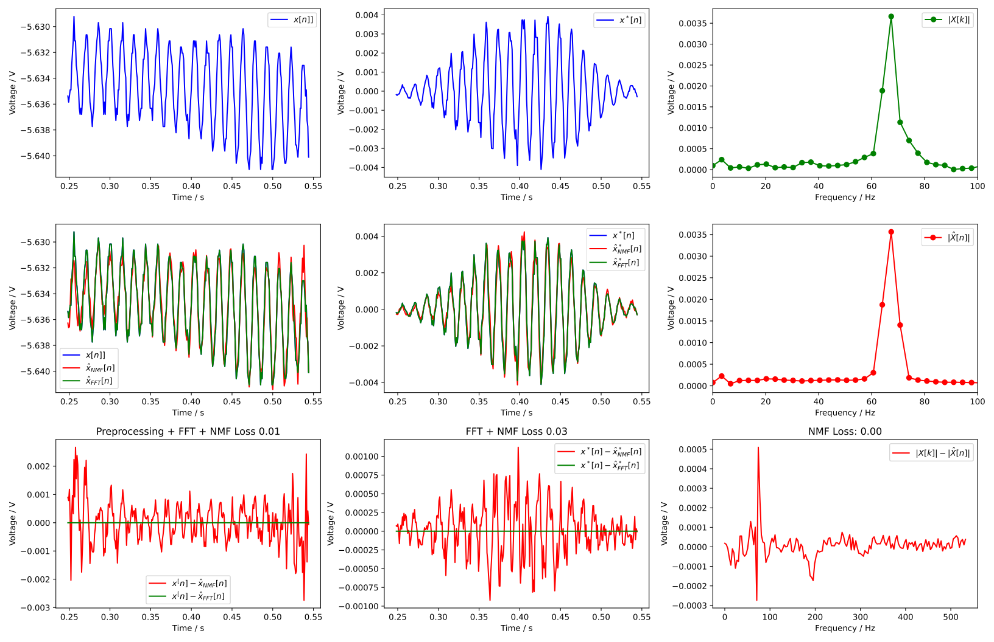
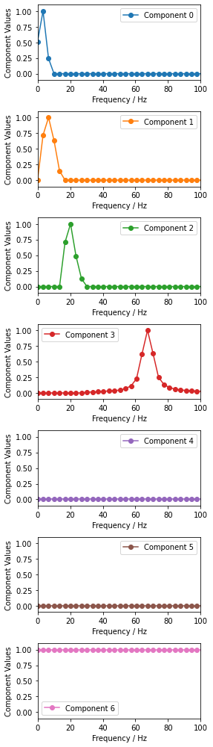
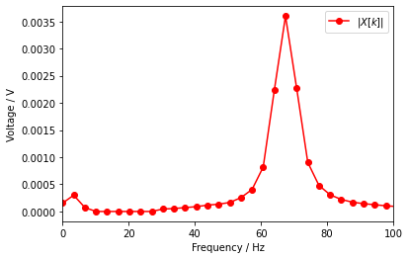

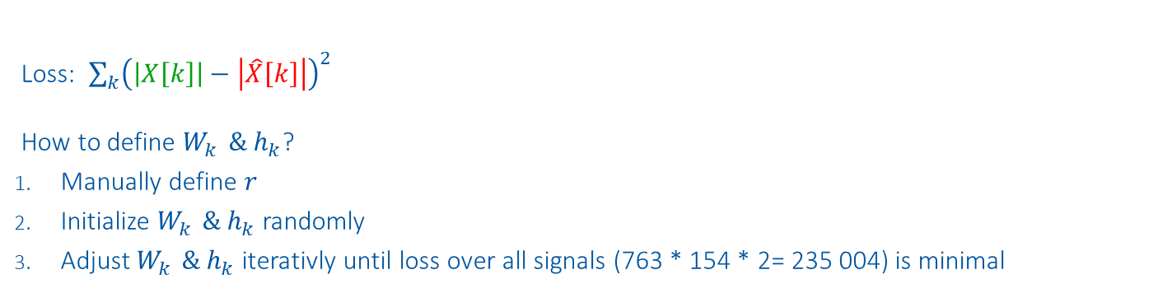
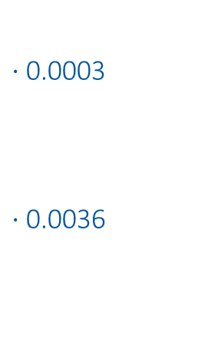
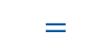
Method
Components
Weights
Input
Reconstruction
$$\left|X\left[k\right]\right| ≈ \sum_{k=1}^{r}{{ W}_{k }{⋅ h}_{k} = |\hat{X}[k]|}$$
$⋅$0.0003
$⋅$0.0036
$$≈$$
$$=$$
Loss: $\sum_{k}{{\left(\left|X\left[k\right]\right|−\left|\hat{X}\left[k\right]\right|\right)}^{2}}$
How to define $W_{k }{\& h}_{k}$?
Manually define $r$
Initialize $W_{k }{\& h}_{k}$randomly
Adjust $W_{k }{\& h}_{k}$iterativly until loss over all signals (763 * 154 * 2= 235 004) is minimal
Example signal: B21R3 on 2021-04-18 08:44:17

Slide 11
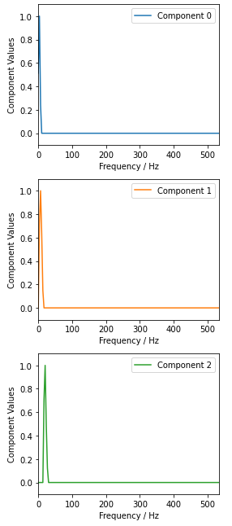
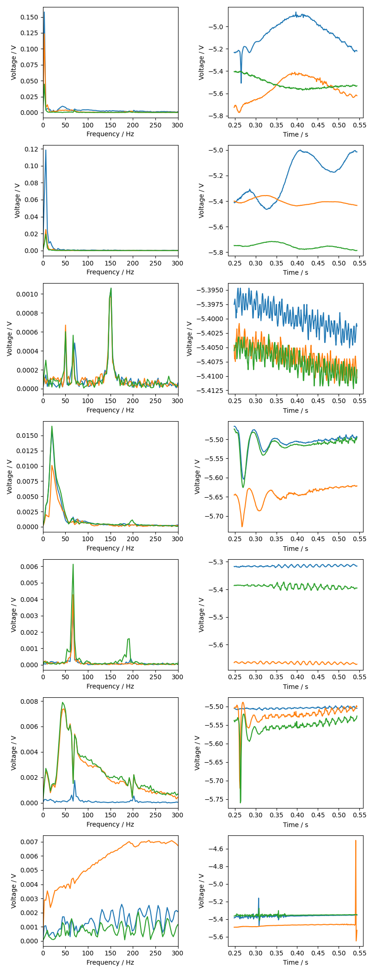
NMF Components
Component Index | Component | 3 Event Examples | Dominant Frequencies | Order of magnitude
0* |  |  | 3 Hz | 100mV
1 |  |  | 6 Hz | 100mV
2 |  |  | 20 Hz | 10mV

Slide 12
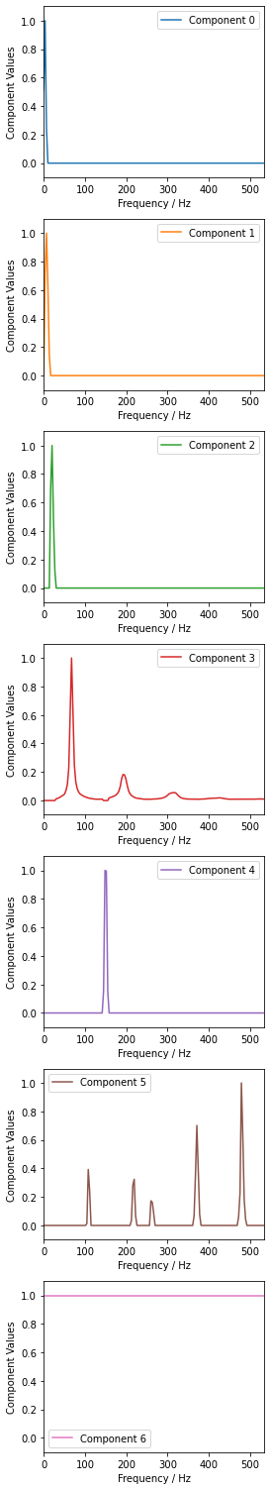
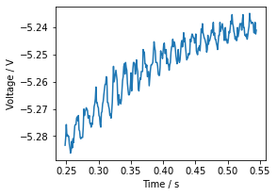
Component Index | Component | 3 Event Examples | Dominant Frequencies [Hz] | Order of magnitude
3 |  |  | 67 Hz 184 Hz 302 Hz | 100mV
4 |  |  | 148 Hz | 1mV
5 |  |  | 107 Hz 220 Hz 260 Hz 370 Hz 478 Hz | 0.1mV
6 |  |  | Any | 100mV

Slide 13
Causal Discovery
Understand normal behavior

Slide 14
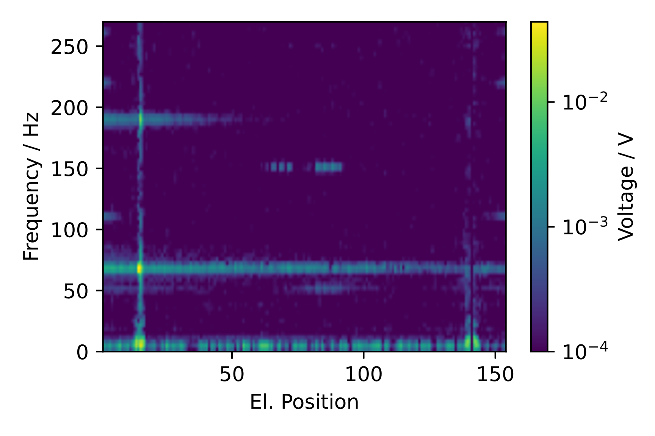
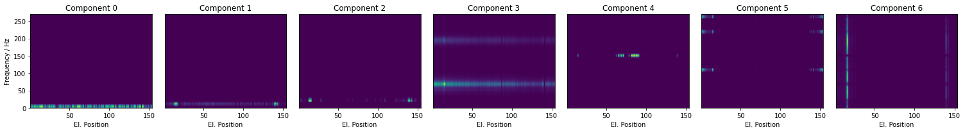







Causal Discovery
Normal event
Frequency components along all magnets in event
$$≈$$
$$+$$
$$+$$
$$+$$
$$+$$
$$+$$
$$+$$
3Hz
6Hz
20Hz
65Hz
143Hz
478Hz
Offset
Electromagnetic perturbation + FFT smiring
Source Direction: Quench
Propagation: Physical
Electromagnetic perturbation
Source Direction: Quench
Propagation: Physical
Left over of voltage wave traveling along the chain of magnets by magnet inductance
Source Direction: Quench
Propagation: Physical
Oscillations caused by quench
Source Direction: Quench
Propagation: Electrical
Repetitive pattern within QPS crate, aliasing?
Source Direction: Quench
Propagation: QPS crate position
Oscillations from the direction of Power converter in RB.A78, aliasing?
Source Direction: Power converter in RB.A78
Propagation: Physical
Oscillations caused by quench
Source Direction: Quench
Propagation: Physical

Slide 15
Outlier Detection
Detect abnormal behavior

Slide 16
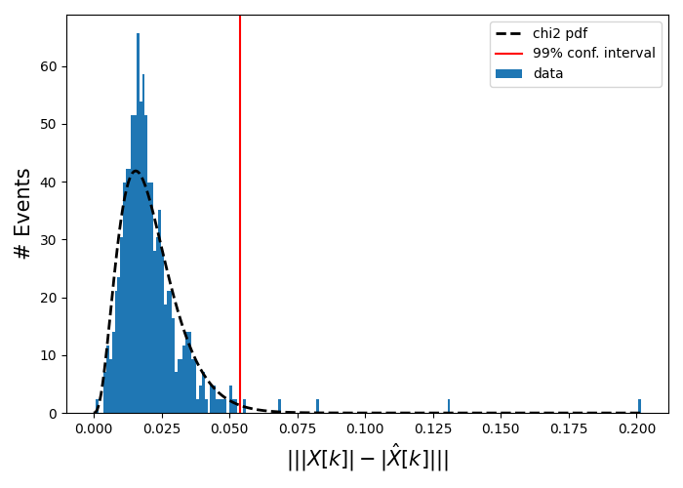
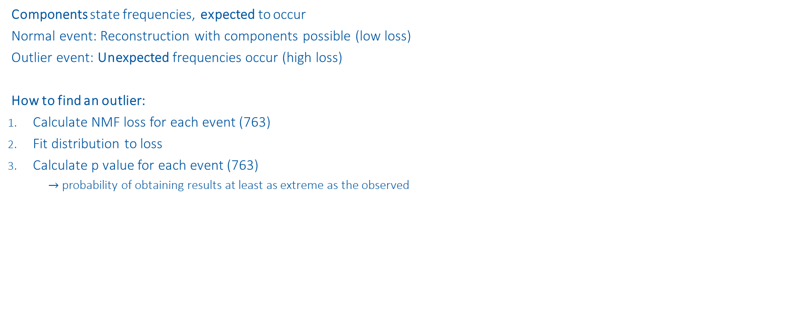
Outlier Detection
Normal event
Components state frequencies, expected to occur
Normal event: Reconstruction with components possible (low loss)
Outlier event: Unexpected frequencies occur (high loss)
How to find an outlier:
Calculate NMF loss for each event (763)
Fit distribution to loss
Calculate p value for each event (763)
$→$probability of obtaining results at least as extreme as the observed
Outliers
Normal

Slide 17
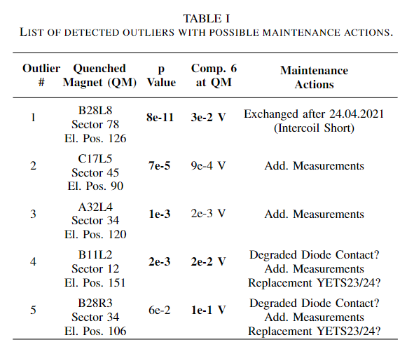
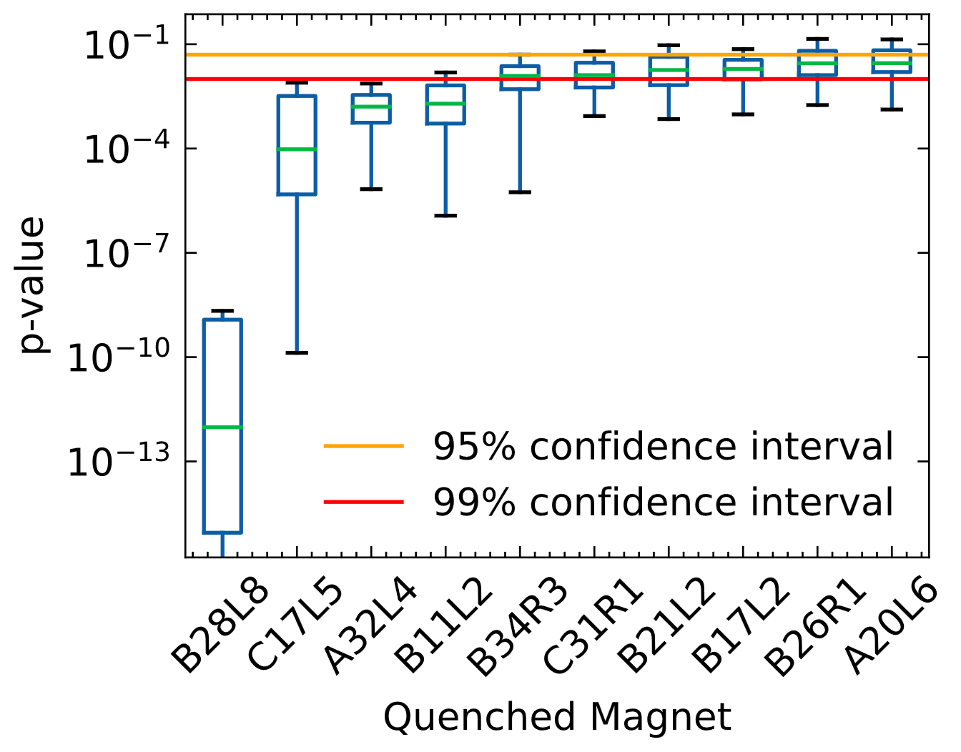
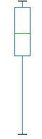
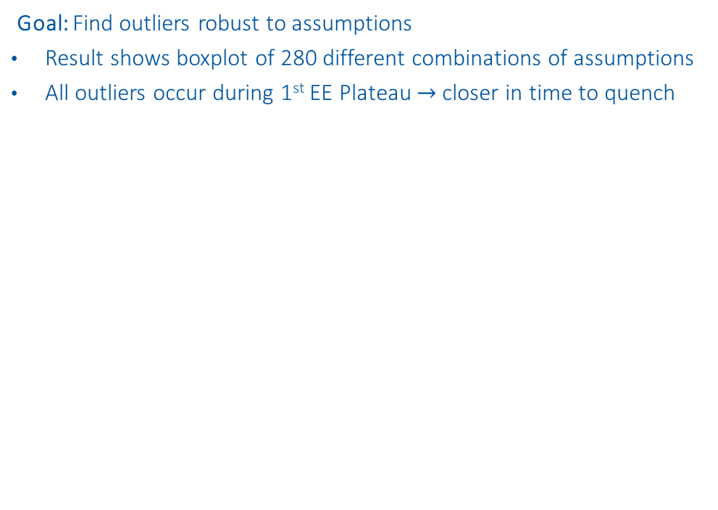
Outliers
Goal: Find outliers robust to assumptions
Result shows boxplot of 280 different combinations of assumptions
All outliers occur during 1st EE Plateau $→$closer in time to quench
Q3 + 1.5 * Box length
3rd Quantil (Q3)
Box
length
Median
1st Quantil (Q1)
Q1 - 1.5 * Box length

Slide 18
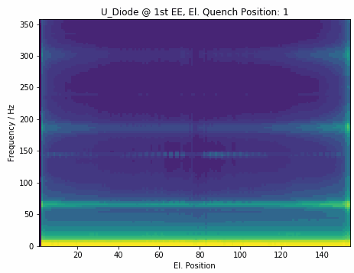
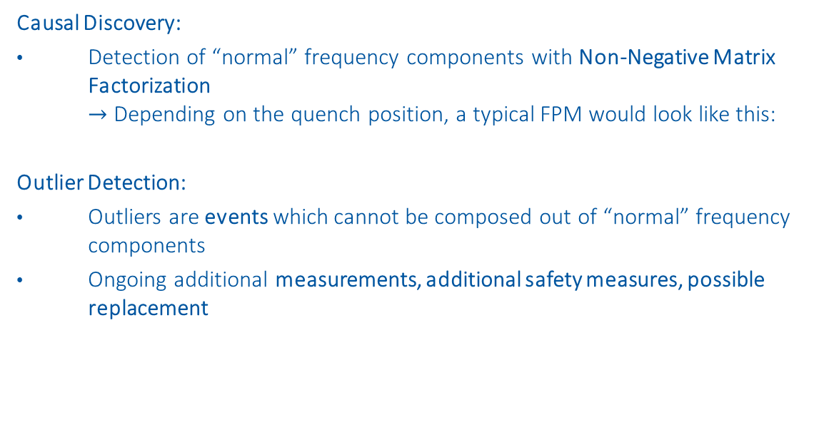
Conclusion
Causal Discovery:
Detection of “normal” frequency components with Non-Negative Matrix Factorization $→$ Depending on the quench position, a typical FPM would look like this:
Outlier Detection:
Outliers are events which cannot be composed out of “normal” frequency components
Ongoing additional measurements, additional safety measures, possible replacement

Slide 20
Backup Slides

Slide 21
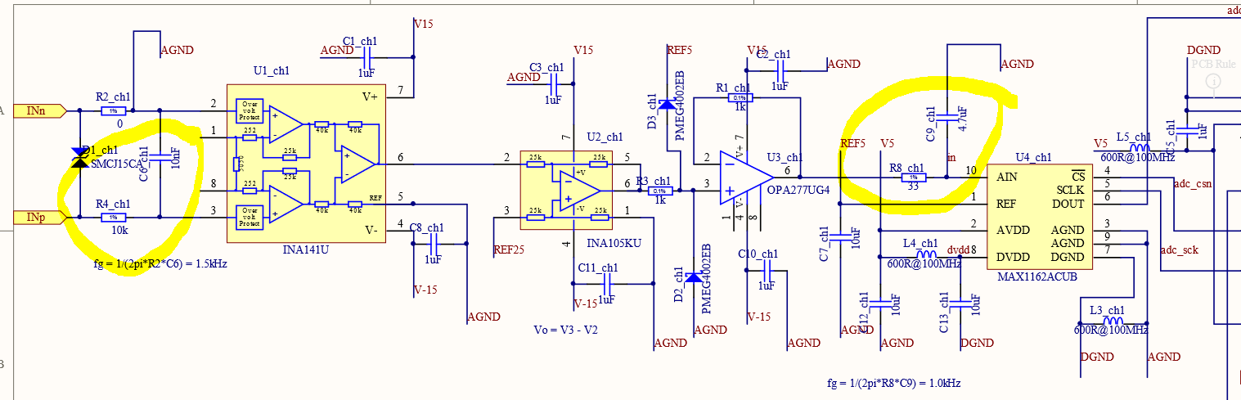
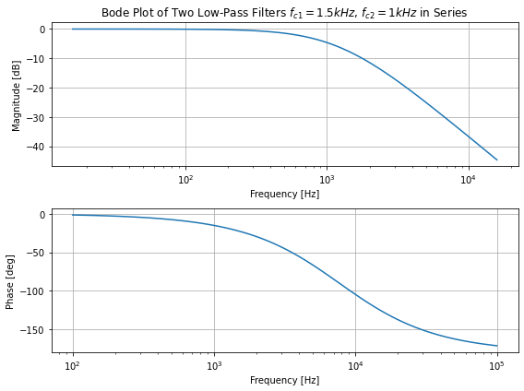
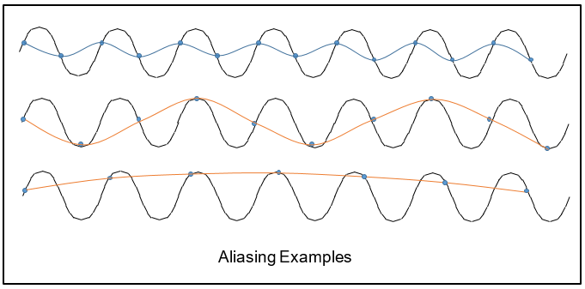
Aliasing
1.5kHz 1st Order lowpass direkt am Eingang und dann noch einen zweiten mit 1kHz vor dem ADC
High frequency components could potentially cause aliasing in results.
Anti-aliasing filters in the nQPS crates:
Two 1st order lowpass filters with 1.5 kHz and 1 kHz cutoff frequency*
Sampling frequency of nQPS crates: 1068 Hz
*provided by Jens Steckert

Slide 22
Fast Fourier transform

Slide 23
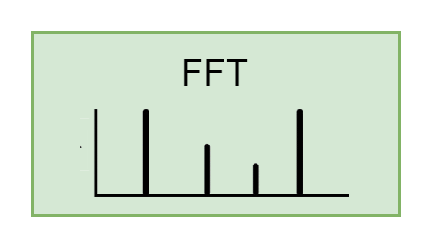
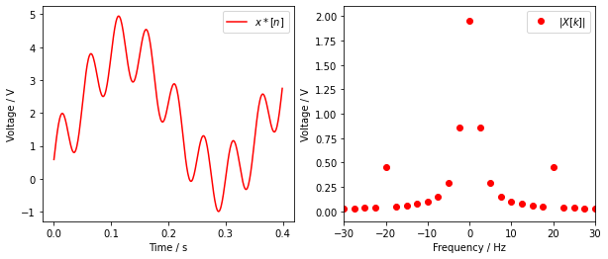
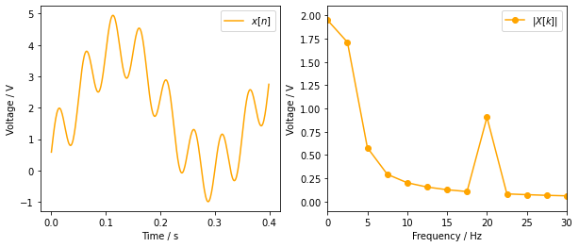
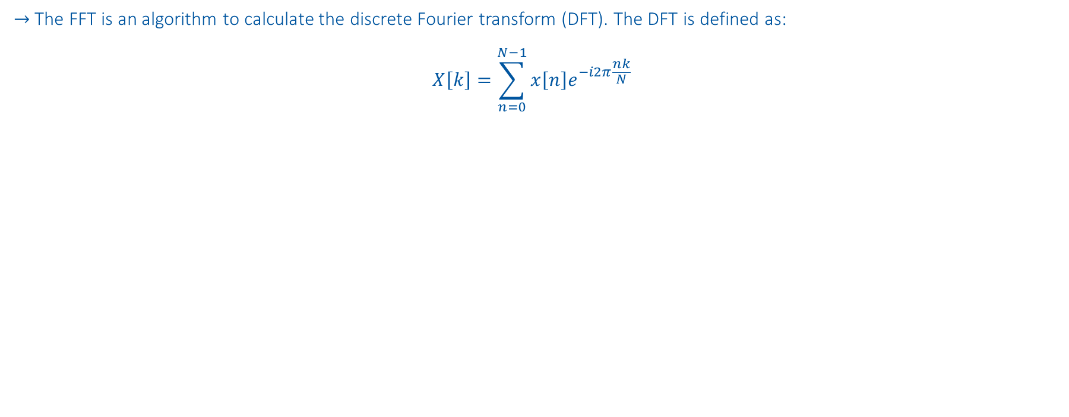
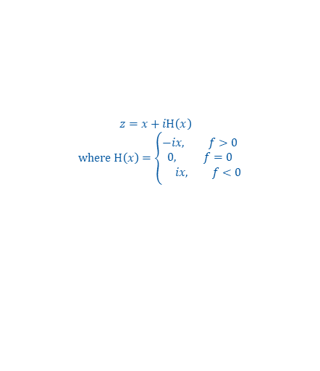
Fast Fourier transform
$→$The FFT is an algorithm to calculate the discrete Fourier transform (DFT). The DFT is defined as:
$$X\left[k\right]=\sum_{n=0}^{N−1}{x\left[n\right]e^{−i2π\frac{nk}{N}}}$$
$$x\left[n\right]=2V+2V∗sin(2π 3Hz∗n −90°) +sin(2π 20Hz∗n)$$
Apply Hilbert transform: Multiply all but first sample of FFT amplitude with 2
$z=x+iH\left(x\right)$
$$where H\left(x\right)=\left\{\begin{aligned}−i&x, f>0 \\ 0, f=0 \\ &ix, f<0\end{aligned}\right.$$
Smearing

Slide 24
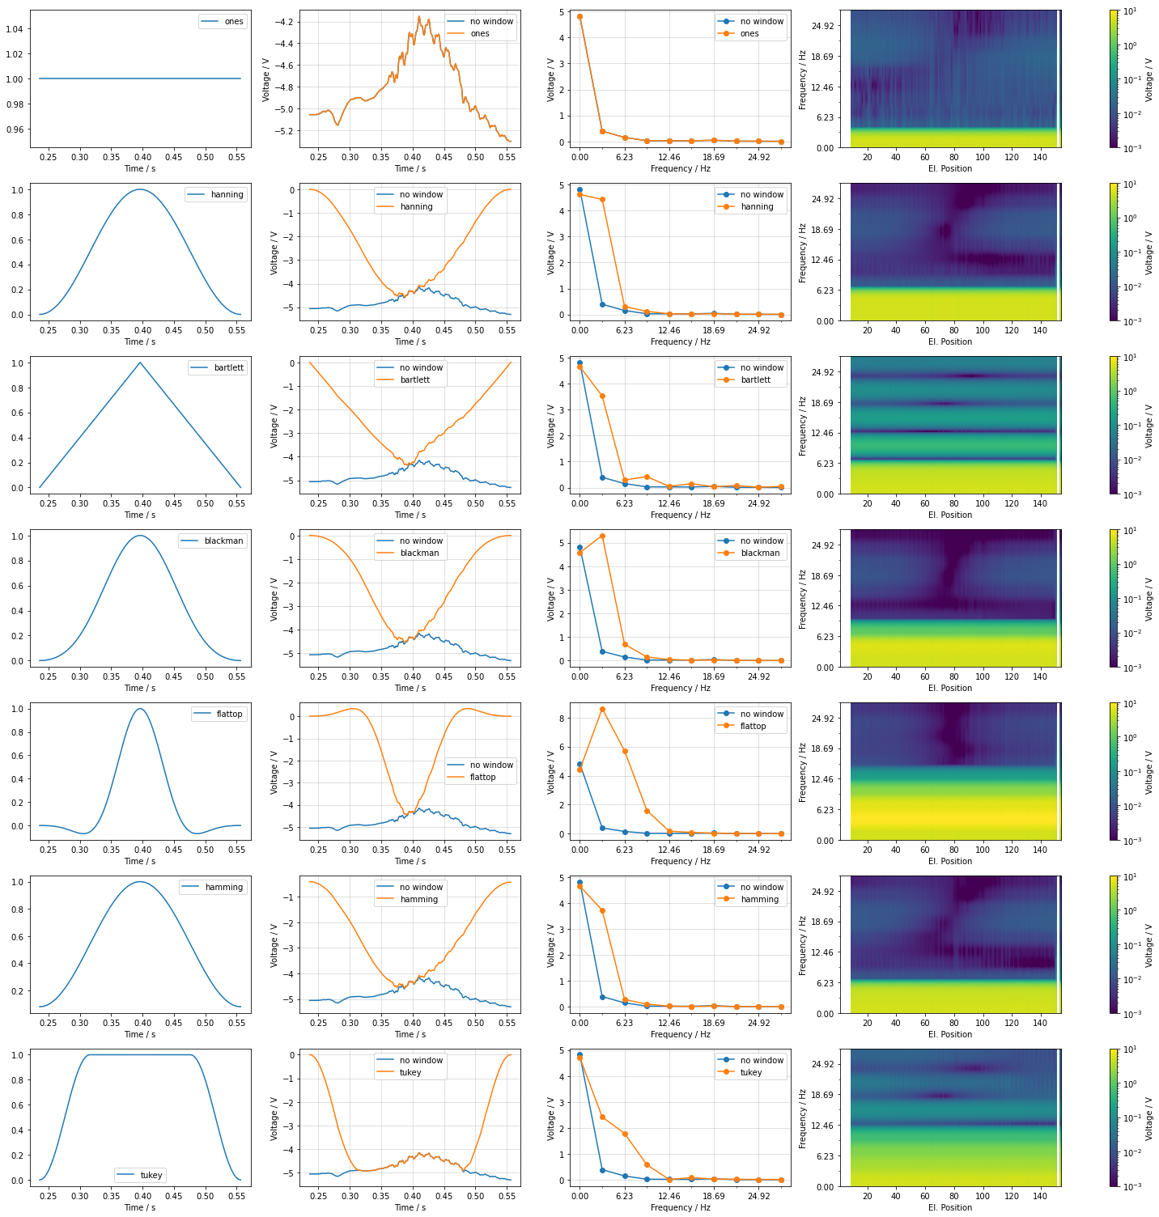
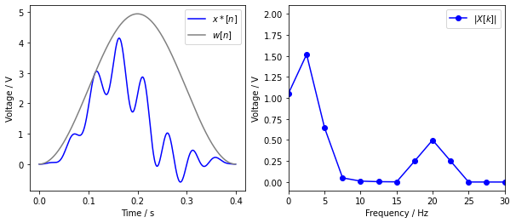
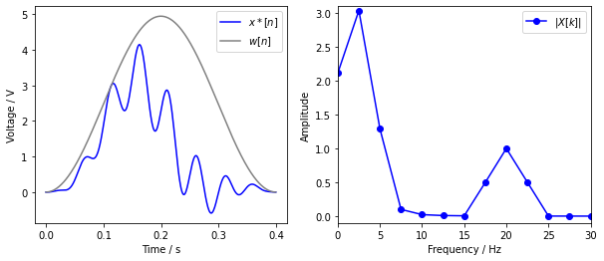


Window data
$→$ Avoid smearing
$$x\left[n\right]=2V+2V∗sin(2π 3Hz∗n −90°) +sin(2π 20Hz∗n)$$
Use Window:
$x^{∗}\left[n\right]=$ $x\left[n\right]∗w[n]$
Wrong Amplitude
Smearing
Add Window gain: Divide $|X\left[k\right]|$ with $\frac{1}{N}\sum_{n}^{N}{w[n]}$
Smearing from DC

Slide 25


Detrend data
$→$Smearing of DC component interferes with low frequency component
$$x\left[n\right]=2V+2V∗sin(2π 3Hz∗n −90°) +sin(2π 20Hz∗n)$$
Smearing from DC
Subtract trend:
$x^{∗}\left[n\right]=$ $(x\left[n\right]−{(p}_{1}n+p_{0}))∗w[n]$

Slide 26


Backwards Path
Signal: B21R3 on 2021-04-18 08:44:17
$$\frac{10 Periods}{0.15 s}=66.7 Hz$$
$$67.4 Hz$$

Slide 27
Non-Negative Matrix Factorization (NMF)
https://www.nature.com/articles/44565
https://proceedings.neurips.cc/paper/2000/file/f9d1152547c0bde01830b7e8bd60024c-Paper.pdf

Slide 28









Objective Function
$$V≈ WH$$
$m …$ number of $i$events * positions (560 x 154)
$n …$ number of frequencies (0-360Hz)
$r …$ number of components (1-5)
$V∈ℝ_{+}^{n×m}$… reconstructed event at position
$W∈ℝ_{+}^{n×r}$… components
$H∈ℝ_{+}^{r×m}$… presence of components
NMF Objective Function:
$\underset{W,H}{\min{ }}f\left(W, H\right)≡\frac{1}{2}{\left\|V−WH\right\|}_{F}^{2}$, s.t. $W, H≥0$
$$≈\sum_{k=1}^{r}{ }$$
$$⋅$$
$$=\sum_{k=1}^{r}{ }$$
$$=$$
$$⋅$$
$$⋅$$
$$⋅$$
$$⋅$$

Slide 29


Backwards Path
Signal: B21R3 on 2021-04-18 08:44:17

Slide 30
Causal Discovery

Slide 31




Component 0 & 1: EM Perturbation
Filter: 20ms moving average
dV is measured similar to sunglass threshold
dV
dV

Slide 32


Component 4 & 5

Slide 33
Outlier Detection

Slide 34
Assumptions
Assumptions for this plot:
Linear detrend
Hamming window
4 components
Frobenius distance
Preprocessing:
Degree of detrend:
0 - Offset
1 - Linear Trend
Window multiplication:
none (best reconstruction, high smearing)
hanning (lowest smearing, no reconstruction)
hamming (low smearing , good reconstruction)
barlett
blackman
flattop (high smearing, accurate amplitude)
tukey
NMF:
n_components (2-12)
Distance measure*:
Frobenius (Eu)
Kullback-Leibler (KL)
280 x
* https://ieeexplore.ieee.org/stamp/stamp.jsp?arnumber=6410389

Slide 35


RB.A78 - B28L8 – Intercoil short
Event with B28L8 quench before:
2021-03-28: „normal“ at EE plateaus

Slide 36

RB.A12 - B11L2
No B11L2 quench before
A11L2, E4
B10L2, E152
A9L2, E3
B9L2, E153

Slide 37
RB.A34 – B28R3
No B28R3 quench before
Most likely scenario of noise from simulations:
Partially emerging resistor, in parallel to diode
Degraded diode contact?

